Slide 1
Introduction to Parallel Processing
Shantanu Dutt
University of Illinois at Chicago

Slide 2
Acknowledgements
Ashish Agrawal, IIT Kanpur, “Fundamentals of Parallel Processing” (slides), w/ some modifications and augmentations by Shantanu Dutt
John Urbanic, Parallel Computing: Overview (slides), w/ some modifications and augmentations by Shantanu Dutt

Slide 3
Outline
Moore's Law
Different performance enhancement techniques
A simple model of Parallel Processing
Performance evaluation of parallelized programs
Classification of Parallel Programming - Distributed and Shared memory
Message Passing Interface
Synchronization and Communication
Load Balancing and Granularity
Examples
Applications
Further Research
Cloud computing
Summary

Slide 4
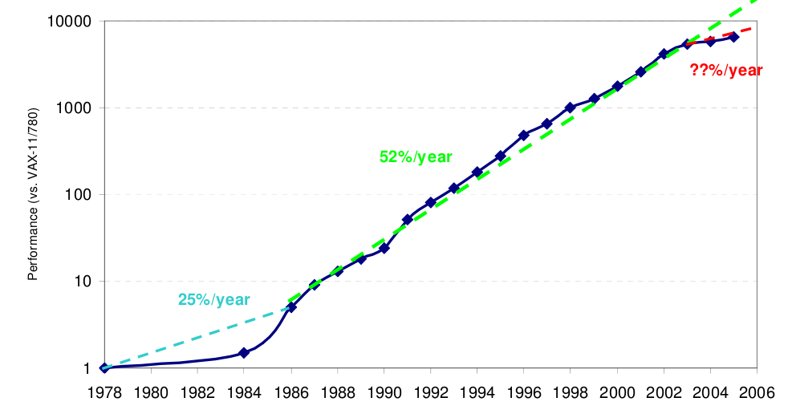
Moore’s Law &
Need for Parallel Processing
Chip performance doubles every 18-24 months
Power consumption is prop. to freq.
Limits of Serial computing –
  Heating issues
  Limit to transmissions speeds
  Leakage currents
  Limit to miniaturization
Multi-core processors already commonplace.
Most high performance servers already parallel.

Slide 5
Quest for Performance
Pipelining
Superscalar Architecture
Out of Order Execution
Caches
Instruction Set Design Advancements
Parallelism
  Multi-core processors
  Clusters
  Grid

Slide 6
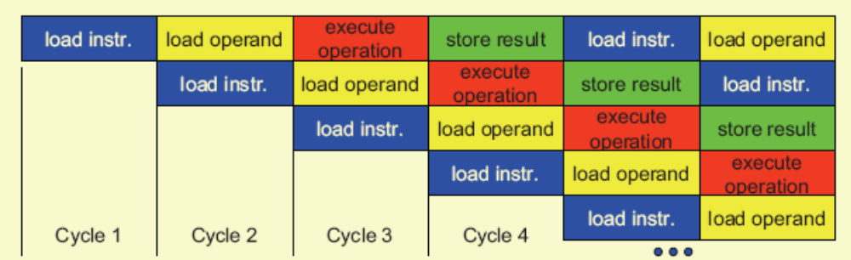
Pipelining
Illustration of Pipeline using the fetch, load, execute, store stages.
At the start of execution – Wind up.
At the end of execution – Wind down.
Data dependency – additional hardware needed.
Pipeline stalls – Hit performance and speedup.
Pipeline depth – No of cycles in execution simultaneously.
Intel Pentium 4 – 35 stages.
Branching/Jumping – Branch prediction?

Slide 7
Cache
Desire for fast cheap and non volatile memory
Memory growth at 7% per annum while processor growth at 50% p.a.
Cache – fast small memory.
L1 and L2 caches.
Retrieval from memory takes several hundred clock cycles
Retrieval from L1 cache takes the order of one clock cycle and from L2 cache takes the order of 10 clock cycles.
Cache ‘hit’ and ‘miss’.
Prefetch used to avoid cache misses at the start of the execution of the program.
Cache lines used to avoid latency time in case of a cache miss
Order of search – L1 cache -> L2 cache -> RAM -> Disk
Cache coherency – Correctness of data. Important for distributed parallel computing.

Slide 8
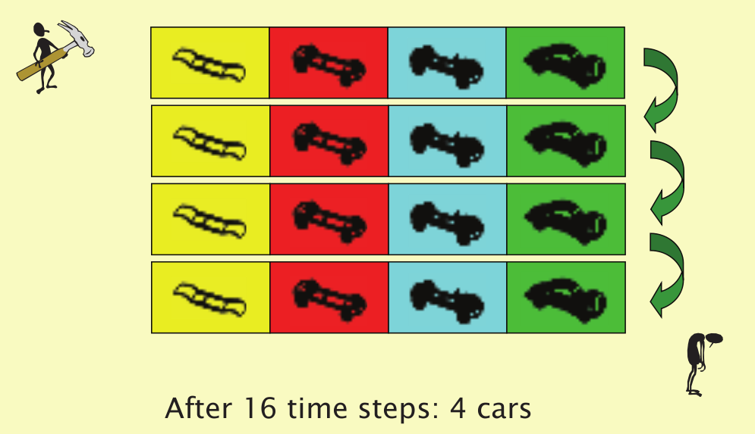
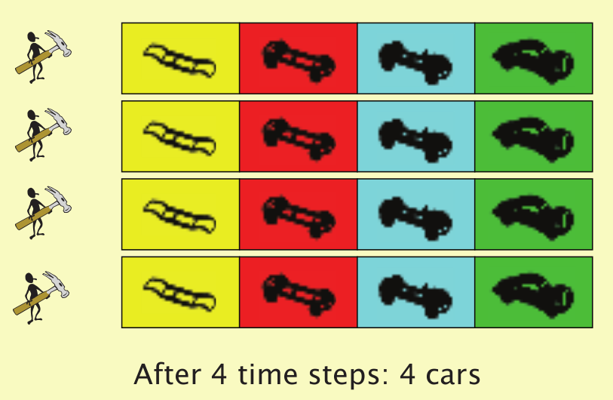
Parallelism - A simplistic understanding
Multiple tasks at once.
Distribute work into multiple execution units.
Two approaches -
  Data Parallelism
  Functional or Control Parallelism
Data Parallelism - Divide the dataset into grids or sectors and solve each sector on a separate execution unit.
Functional Parallelism – Divide the 'problem' into different tasks and execute the tasks on different units.

Slide 9
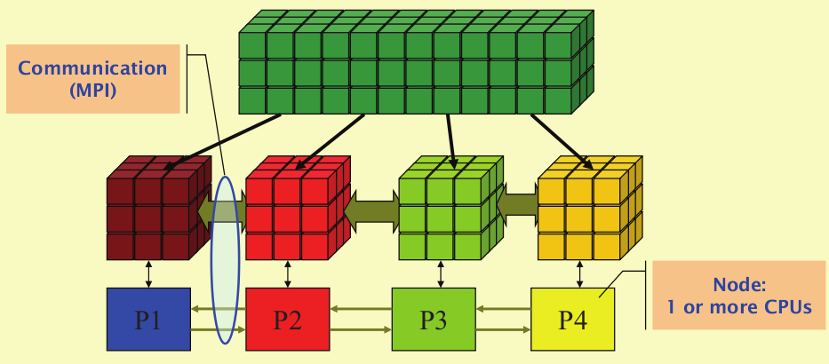
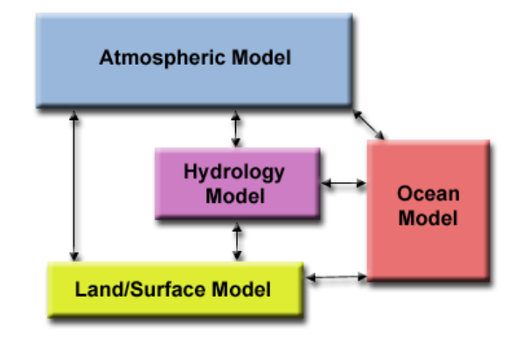

Slide 10
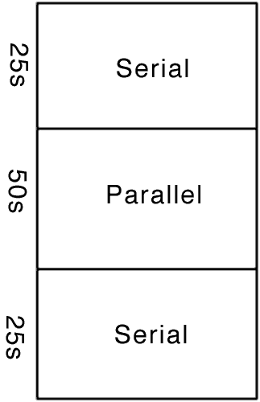
Amdahl’s Law
How many processors can we really use?
Let’s say we have a legacy code such that is it only feasible to convert half of the heavily used routines to parallel:

Slide 11
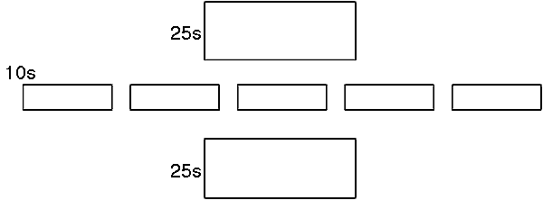
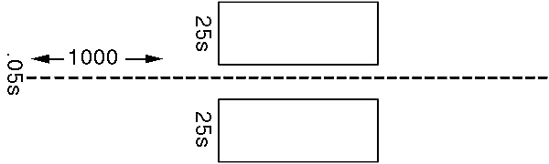
Amdahl’s Law
If we run this on a parallel machine with five processors:
Our code now takes about 60s. We have sped it up by about 40%. Let’s say we use a thousand processors:
We have now sped our code by about a factor of two.

Slide 12
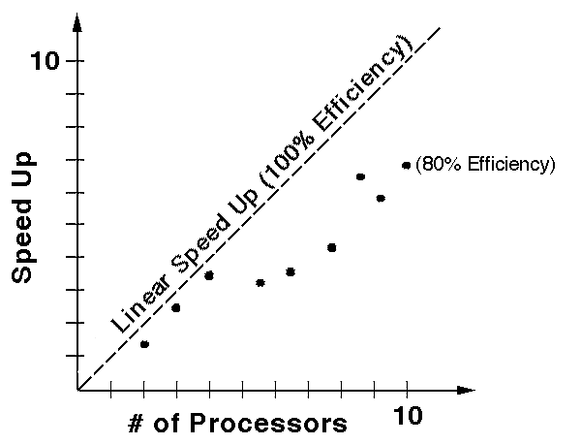
Amdahl’s Law
This seems pretty depressing, and it does point out one limitation of converting old codes one subroutine at a time. However, most new codes, and almost all parallel algorithms, can be written almost entirely in parallel (usually, the “start up” or initial input I/O code is the exception), resulting in significant practical speed ups. This can be quantified by how well a code scales which is often measured as efficiency.

Slide 13
Parallel Processing & Arch. Classification
Flynn's Classical Taxonomy -
  Single Instruction, Single Data (SISD)—your single-core uni-processor PC
  Single Instruction, Multiple Data (SIMD)—special purpose low-granularity multi-processor m/c w/ a single control unit relaying the same instruction to all processors (w/ different data) every cc
  Multiple Instruction, Single Data (MISD)—pipelining is a major example
  Multiple Instruction, Multiple Data (MIMD)—the most prevalent model. SPMD (Single Program Multiple Data) is a very useful subset. Note that this is v. different from SIMD. Why?
Note that Data vs Control Parallelism is another independent classification
Multi-processor Architectures-
  Shared Memory
    Uniform Memory Access (UMA)‏
    Non- Uniform Memory Access (NUMA)‏
      Cache Coherent NUMA (ccNUMA)‏
  Distributed Memory—Most prevalent architecture model for # processors > 8
  Hybrid Distributed Shared memory

Slide 14
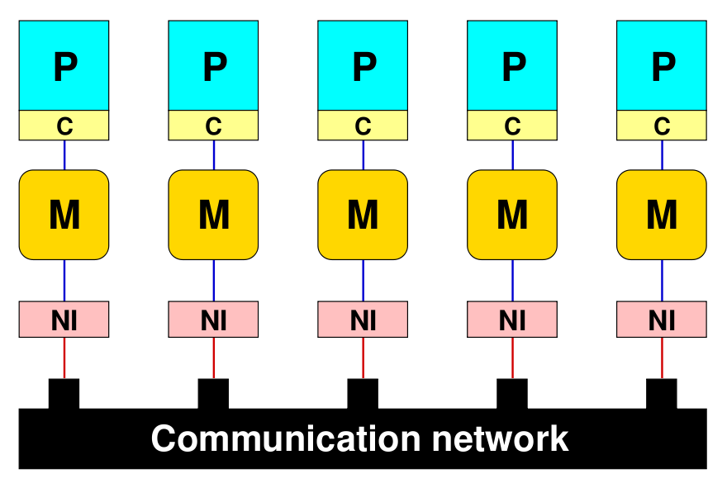
Distributed Memory—Message Passing Architectures
Each processor P (with its own local cache C) is connected to exclusive local memory, i.e. no other CPU has direct access to it.
Each node comprises at least one network interface (NI) that mediates the connection to a communication network.
On each CPU runs a serial process that can communicate with other processes on other CPUs by means of the network.
Non-blocking vs Blocking communication

Slide 15
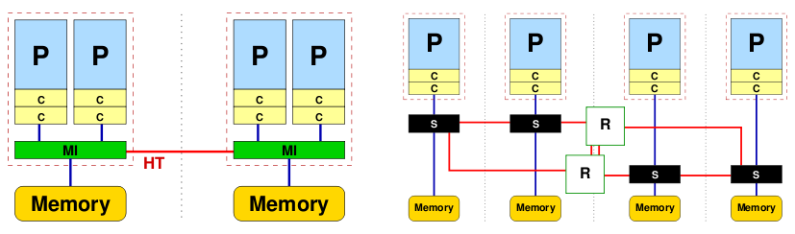
Distributed Shared Memory Arch.: NUMA
Memory is physically distributed but logically shared.
The physical layout similar to the distributed-memory case
Aggregated memory of the whole system appear as one single address space.
Due to the distributed nature, memory access performance varies depending on which CPU accesses which parts of memory (“local” vs. “remote” access).
Two locality domains linked through a high speed connection called Hyper Transport
Advantage – Scalability
Disadvantage – Locality Problems and Connection congestion.

Slide 16
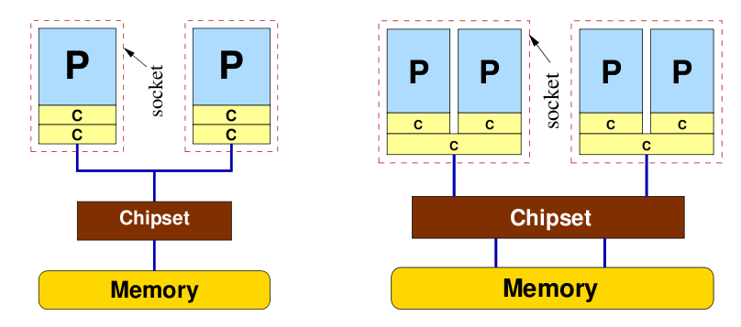
Distributed Shared Memory Arch.: UMA
Flat memory model
Memory bandwidth and latency are the same for all processors and all memory locations.
Simplest example – dual core processor
Most commonly represented today by Symmetric Multiprocessor (SMP) machines
Cache coherent UMA

Slide 17
Message Passing Interface (MPI)—A distributed memory parallel prog. language
Synchronizes well with Data Parallelism.
The same program on each processor/machine (SPMD—a v. useful subset of MIMD)‏
Each process distinguished by its rank.
The program is written in a sequential language (FORTRAN/C[++])‏
All variables are local! No concept of shared memory
Data exchange between processes through Send/receive messages via appropriate library
MPI System requires information about
  Which processor is sending the message.
  Where is the data on the sending processor.
  What kind of data is being sent.
  How much data is there.
  Which processor (s) are receiving the message.
  Where should the data be left on the receiving processor.
  How much data is the receiving processor prepared to accept.

Slide 18
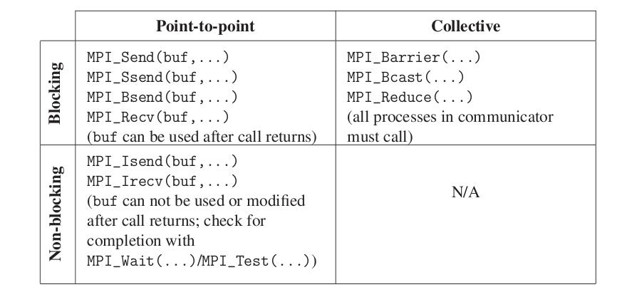
Message Passing Interface—Some Communication Routines
Result-
  Hello World! I am 3 of 4
  Hello World! I am 1 of 4
  Hello World! I am 0 of 4
  Hello World! I am 2 of 4

Slide 19
Synchronization and Communication
Cost of communication – Overheads, wait due to synchronization
Latency - The time it takes to send a minimal (0 byte) message from one point to another.
Bandwidth - The amount of data that can be communicated per unit of time.
Visibility of communication – MPI – visible, Data Parallel – Transparent (this is so in all message-passing models)
Blocking (wait until the data is transferred) versus non-blocking communication.
Point to point versus Collective communication.
Synchronization -
Barriers – Consistent access to all information in variables with shared scope
Lock/Semaphores – To prevent violation of data/ race conditions/ deadlocks and control access into critical regions.
Synchronous operations
All this hits performance !

Slide 20
Load Balancing and Granularity
Load balancing refers to the practice of distributing work among tasks so that all tasks are kept busy all of the time. It can be considered a minimization of task idle time.
If data is fairly homogeneous then an equal partition of the work among different tasks suffices else a dynamic work assignment strategy needs to be used.
Granularity – Computation/ Communication ratio
Fine grain parallelism – Relatively small amounts of computation between communication events. Needs very active low-level load balancing.
Coarse grain parallelism – Significant work done between communications. Also needs load balancing, but at a higher level of granularity
In general since communication overheads are significant, coarse grain parallelism is preferred though depending on the architecture, hardware and the actual problem fine grain parallelism could be more advantageous as it reduces load imbalances.

Slide 21
More on Load Balancing
An important consideration which can be controlled by communication is load balancing:
Consider the case where a dataset is distributed evenly over 4 sites. Each site will run a piece of code which uses the data as input and attempts to find a convergence. It is possible that the data contained at sites 0, 2, and 3 may converge much faster than the data at site 1. If this is the case, the three sites which finished first will remain idle while site 1 finishes. When attempting to balance the amount of work being done at each site, one must take into account the speed of the processing site, the communication "expense" of starting and coordinating separate pieces of work, and the amount of work required by various pieces of data.
There are two forms of load balancing: static and dynamic.

Slide 22
More on Load Balancing – Cont’d
Static Load Balancing
In static load balancing, the programmer must make a decision and assign a fixed amount of work to each processing site a priori.
Static load balancing can be used in either the Master-Slave (Host-Node) programming model or the "Hostless" programming model.

Slide 23
More on Load Balancing – Cont’d
Static Load Balancing yields good performance when:
homogeneous cluster
each processing site has an equal amount of work
Poor performance when:
heterogeneous cluster where some processors are much faster (unless this is taken into account in the program design)
work distribution is uneven, i.e., problem is irregular in nature

Slide 24
More on Load Balancing – Cont’d
Dynamic Load Balancing
Dynamic load balancing can be further divided into the categories:
task-oriented
when one processing site finishes its task, it is assigned another task (this is the most commonly used form).
data-oriented
when one processing site finishes its task before other sites, the site with the most work gives the idle site some of its data to process (this is much more complicated because it requires an extensive amount of bookkeeping).
Dynamic load balancing is ideal for:
codes where tasks are large enough to keep each processing site busy
codes where work is uneven (i.e., the underlying problem is irregular)
heterogeneous clusters

Slide 25
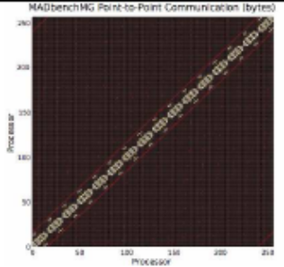
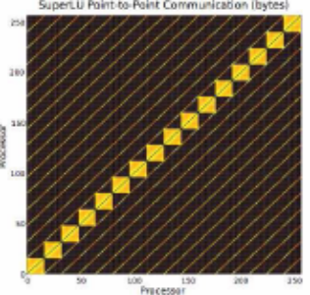
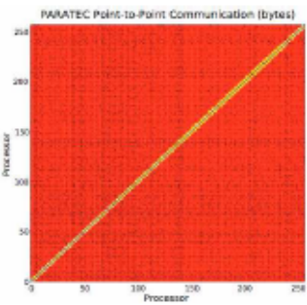
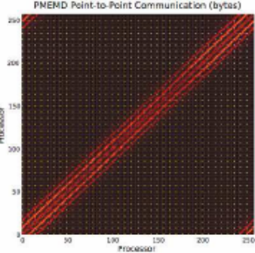
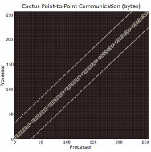
Basic computational problems
Dense Linear Algebra
  JPEG, MPEG, convolution, IP processing, MATLAB, SVM, PCA, Database Hash
Sparse Linear Algebra
  Fluid dynamics, linear program solver, Reverse Kinematics/spring models(games)
Spectral methods
  Spectral Clustering, texture maps, FFT
N-body methods
  Molecular dynamics
Structured grids
  FEM, Lattice Boltzmann, smoothing/interpolation (games), weather modelling
Unstructured Grids
  Belief propagation
Monte – Carlo
  Expectation Maximization, Option pricing

Slide 26
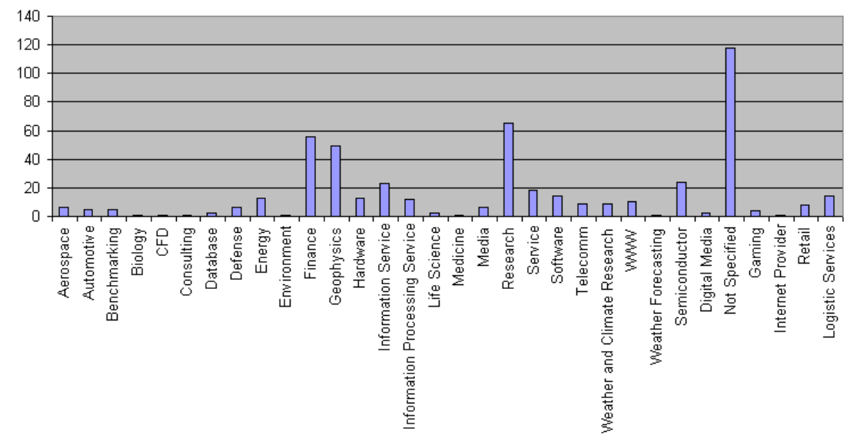
Applications of Parallel Processing

Slide 27
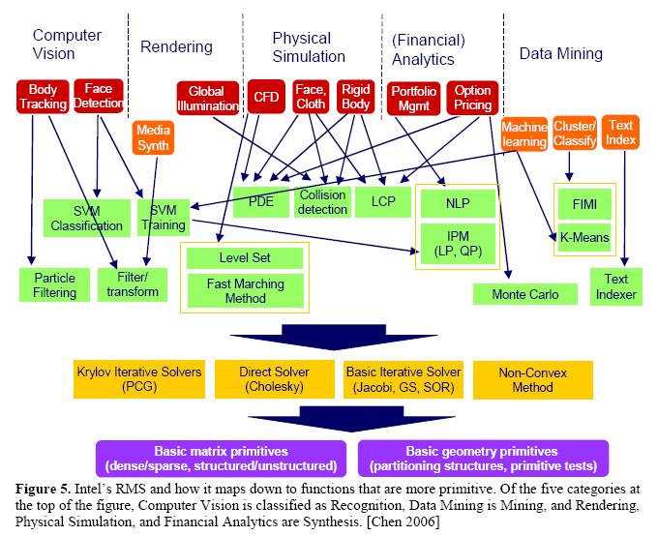

Slide 28
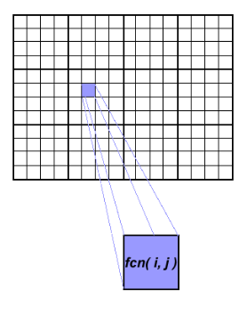
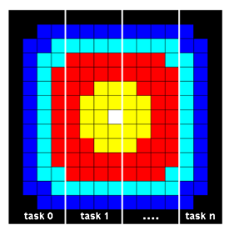
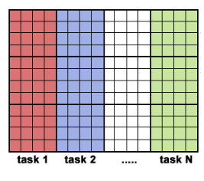
Example problems & solutions
Embarrassingly Parallel Situation – Each data part is independent. No communication is required between the execution units solving two different parts.
Heat Equation -
The initial temperature is zero on the boundaries and high in the middle
The boundary temperature is held at zero.
The calculation of an element is dependent upon its neighbor elements

Slide 29
update border of my portion of solution array
determine if my solution has converged
send MASTER convergence data
receive from MASTER convergence signal
end do
send MASTER results
endif
find out if I am MASTER or WORKER
if I am MASTER
initialize array
send each WORKER starting info and subarray
do until all WORKERS converge
gather from all WORKERS convergence data
broadcast to all WORKERS convergence signal
end do
receive results from each WORKER
else if I am WORKER
receive from MASTER starting info and subarray
do until solution converged
update time
non-blocking send neighbors my border info
non-blocking receive neighbors border info
update interior of my portion of solution array
wait for non-blocking communication complete
  Serial Code -
  do iy=2, ny-1
  do ix=2, nx-1
  u2(ix,iy)=u1(ix,iy)+cx*{u1(ix+1,iy)}+u1(ix-1,iy)-2*u1(ix,iy)+cy*{u1(iX,iy+1)}+u1(ix,iy-1)-2*u1(ix,iy)‏
  enddo
  enddo

Slide 30
What lies ahead ?
GPU(Graphic Processing Units) are already in the teraflop range.
Increased use of parallelism would help model physical processes in animation better.
1000 core processors envisaged feasible when processor technology is in the 30 nm range (currently in the 45 nm range).
Parallelism (despite the difficulties in programming) is definitely the way ahead.
Programming models and languages with inherent support for parallelism, also be more human centric.
Deal with bit level, instruction level, task level and data level parallelism.
Autotuners as a substitute to existing compilers.
Richer hardware support for maintaining cache coherency in 1000 core machines.
Pipelining, out of order execution and other innovations of the single core processor will probably be done away with to make room for more cores on a chip.

Slide 31
Cloud Computing
To take away the core processing abilities from the Personal Computer and put it in the ‘cloud’.
Cloud consists of millions (billions?) of processors distributed across the world.
User applications like office, database applications etc. can all be put on the cloud.
Google’s appengine allows one to upload his own applications on the net which everybody can use.
Despite the advantages of the cloud for user oriented processes it is unlikely to be a contender for High Performance Computing applications.
Communication costs and latency are too high to allow parallelization across the world. (Remote access of memory is costly)

Slide 32
Summary
Serial computers will probably not get much faster - Parallelization unavoidable.
Pipelining, cache and other optimization strategies for serial computers
Amdahl’s law – Parallel computer performance.
Data and Functional Parallelism
Flynn’s taxonomy
Memory models –
  Shared Memory
    Uniform Memory Access
    Non Uniform Memory Access
  Distributed Memory
Message Passing Interface
Synchronization and communication
Load Balancing and Granularity
Applications and examples

Slide 33
References
Computer Organization and Design– Patterson Hennessey
Modern Operating Systems – Tanenbaum
Concepts of High Performance Computing – Georg Hager Gerhard Wellein
Cramming more components onto Integrated Circuits – Gordon Moore, 1965
Introduction to Parallel Computing – https://computing.llnl.gov/tutorials/parallel_comp
The Landscape of Parallel Computing Research – A view from Berkeley, 2006
Thank you !

